Slide 1
Hypercalcemia: a clinical approach
Cachat F
Pediatric Department, HRC, Aigle-Vevey, Switzerland
Department of Pediatrics, Pediatric Nephrology Unit
University Hospital, Lausanne, Switzerland

Slide 2
Goals of presentation
At the end of the presentation, the reader should have a good knowledge of:
  Basic understanding of calcium metabolism (vitamin D, PTH)
  Basic understanding of molecular controls of calcium metabolism (CaSR)
  Clinical aspects of hypercalcemia
  Basic investigations of hypercalcemia
  Therapy of hypercalcemia

Slide 3
Endocrine aspect of calcium metabolism

Slide 4
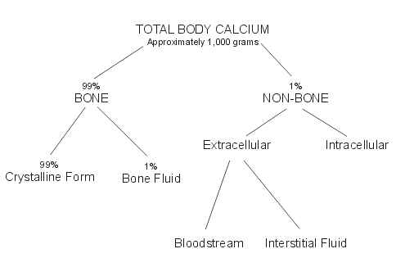
Calcium distribution
Osteoporosis?

Slide 5
Non osseous calcium
Serum calcium (total calcium, bound and unbound) (sensitive to plasma protein binding (total protein, pH)) 2.15-2.6 mmol/L
Ionized calcium (active form) 1.1-1.4 mmol/l
Functions of calcium
  Intracellular signalling
  Coagulation
  Bone mineralization
  Plasma membrane potential (Intracellular calcium concentration10⁻⁷ to 10⁻⁵ M., extracellular calcium concentration of calcium 2 × 10⁻³ M (2 mM)
Notes:
Protein binding – 80% albumin, 20% globulins
Ca binds to –vely charged sites of proteins thus alkalosis leads to an increase in negative charge on proteins and more Ca binding to proteins – decreased free ca
Complexes with lactate/phosphate/bicarbonate/citrate

Slide 6
Calcium homeostasis: hormonal control
Parathyroid
gland
Vitamin D
Skeleton
Ca⁺⁺
Intestine
Kidneys
Notes:
Bone is not metabolically inert there is a constant movement of calcium from bone and the ECF in bone remodelling

Slide 7
Vitamin D
Vitamin D actions:
  Absorption of phosphate and calcium from intestine
  Absorption of phosphate and calcium from kidney
  PTH suppression (1,25 OH vit D)
  Other cardiovascular, immune and proliferation functions
  Overall effect: ↑ serum calcium and phosphate
Notes:
Levels of 1,25 OHD do not decrease until defy is severe
D2 - ergocalciferol

Slide 8
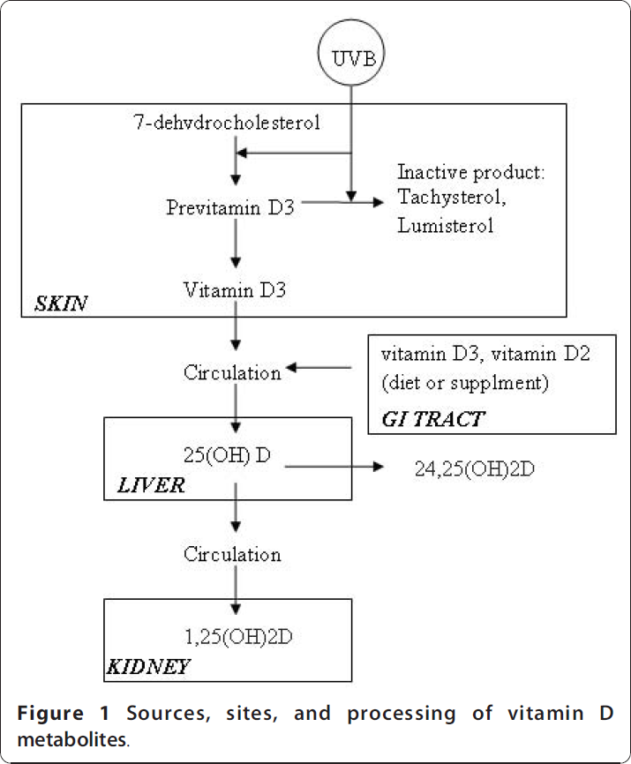
Vitamin D: types and sources
(ergocalciferol, D2)
Diet (cholecalciferol, D3)/UV sunlight (ergocalciferol, D2)
25 (OH) D (liver) (reflects reserve)
1,25 di(OH) Vitamin D (kidney) – responsible for function
(cholecalciferol)
(25(OH)
cholecalciferol)
(24,25 di(OH)
cholecalciferol)
(calcitriol)

Slide 9
Types of vitamin D
Natural
Vitamin D1 molecular compound of ergocalciferol ---
Vitamin D2 ergocalciferol Ergocalciferol®, Zyma D2®
Vitamin D3 cholecalciferol Vide3®, D3Wild®
Vitamin D4 22-dihydroergocalciferol ---
Vitamin D5 sitocalciferol ---
Calci(fe)diol 25(OH) cholecalciferol Dedrogyl ®
Calcitriol 1,25(OH)₂ cholecalciferol Calcitriol®, Rocaltrol®
Synthetic
Dihydrotachysterol 1α(OH)D3 AT10®, Un Alpha®
Paricalcitol 1,25(OH) cholecalciferol Zemplar ®

Slide 10
PTH
Synthesised by parathyroid gland
Bio activity in aa 1-34 (fragments)
Intact PTH T_{1/2} 3-4 min
Inhibited by
  Hypercalcemia (secretion)
  1,25 di(OH) vitamin D (synthesis)
Normal levels 1.3 – 6.8 pmol/L
Importance of calcium sensing receptors for its level of expression
Notes:
Intact PTH assays may detect intact aswell as N terminal fragments 7-84aa.

Slide 11
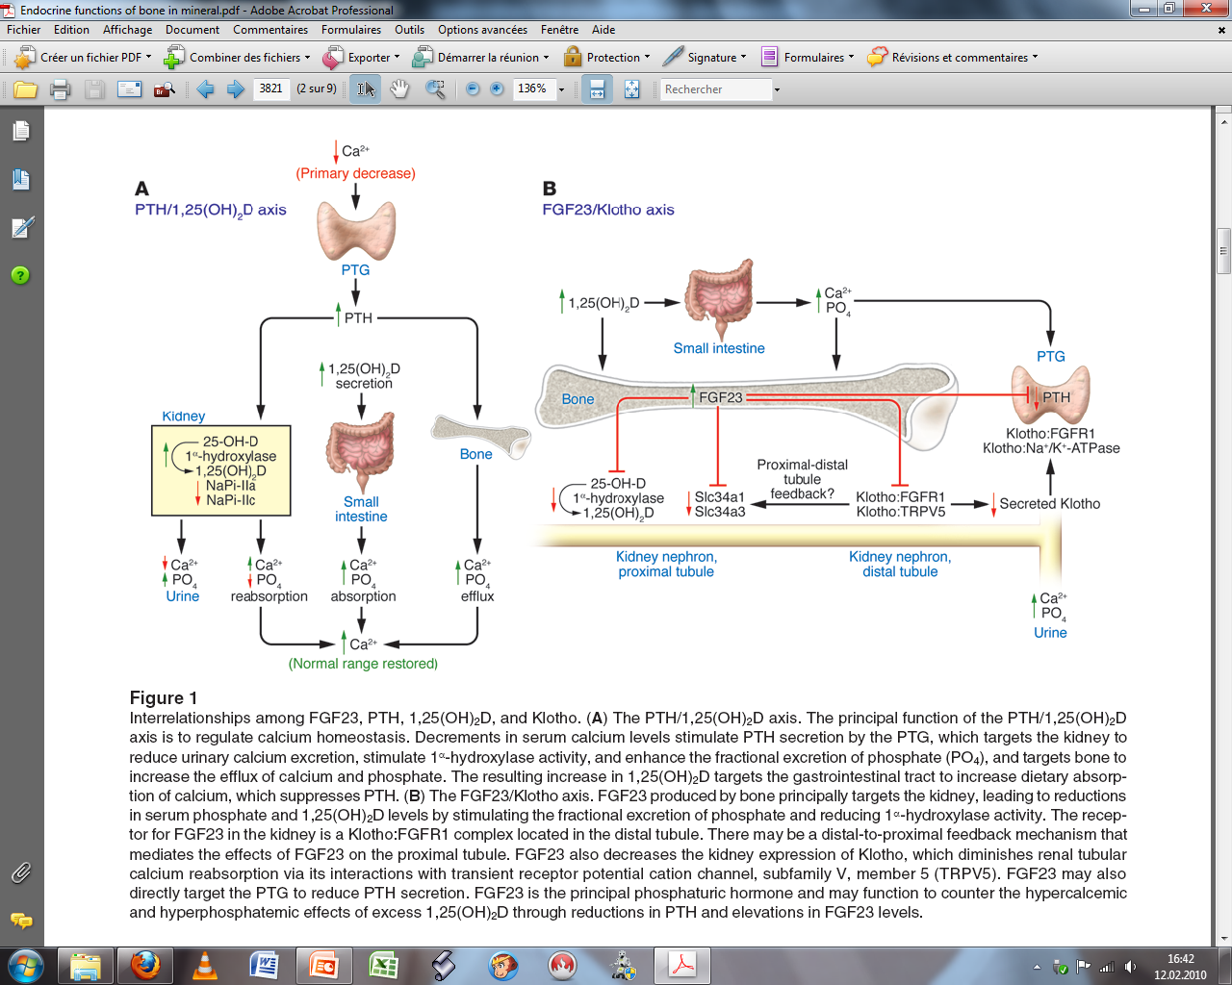
PTH function
PTH actions:
  - Absorption of phosphate and calcium from intestine (via vitamin D)
  Absorption of calcium from kidney
  Excretion of phosphate from kidney
  Mobilization of calcium and phosphate from bone
  - Overall effect: ↑ serum calcium and ↓ serum phosphate

Slide 12
Physiological control of calcium: a summary
Hormone Blood Bone Gut Kidney
PTH ↑Ca, ↓PO4 ↑osteoclast indirect effect ↑Ca excretion
resorbtion through ↑PO4 excretion
calcitriol
Calcitriol ↑Ca, ↑PO4 no direct ↑Ca and PO4 no direct effect
effect absorption
Calcitonin ↓Ca, ↓PO4 ↓osteoclast no direct ↑Ca excretion
resorbtion effect ↑PO4 excretion
From: Carroll M. A practical approach to hypercalcemia. Am Fam Phys 2003;67:1959-1966

Slide 13
Molecular aspects of calcium metabolism

Slide 14
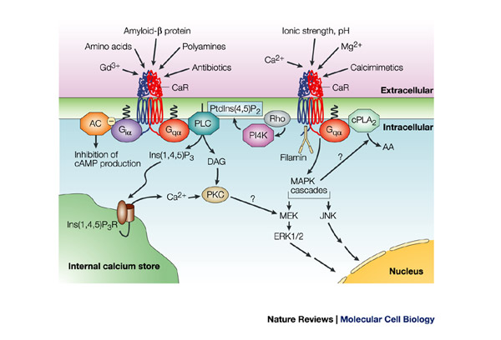
Physiology of the CaSR

Slide 15
The role of the CaSR
Sense the extracellular calcium for PTH synthesis
  CaSR gain of function
    Hypocalcemia, hypoPTH, hypercalciuria
  CaSR loss of function
    Hypercalcemia, hyperPTH, hypocalciuria

Slide 16
Case presentation: questions

Slide 17
Case presentation 1
6 month-old-infant
Vomiting for one week
Normal biochemistries except for mild hypercalcemia with ionized calcium 1.6 mmol/l and total calcium 2.75
Receives vitamin D prophylaxis 400 IU/day
Differential diagnosis? What to do? Emergency situation?

Slide 18
Case presentation 2
6-year-old infant
Headaches, trismus, irritability
Admitted in peds hematology-oncology for metastatic undifferentiated sarcoma
Total calcium 4.01 mmol/l
Polyuria, abdominal pain, constipation
BP 135/84 mm Hg
Differential diagnosis? What to do? Emergency situation?

Slide 19
Definition / pathophysiology / investigation of hypercalcemia in infancy

Slide 20
Definition of hypercalcemia
Ionized calcium > 1.35 mmol/l (5.4 mg/dl) or
total calcium > 2.7 mmol/l (10.8 mg/dl)
Repeated at least twice
Rule out extremely high albumin, total protein, paraprotein level (pseudo-hypercalcemia) (normal ionized calcium!)

Slide 21
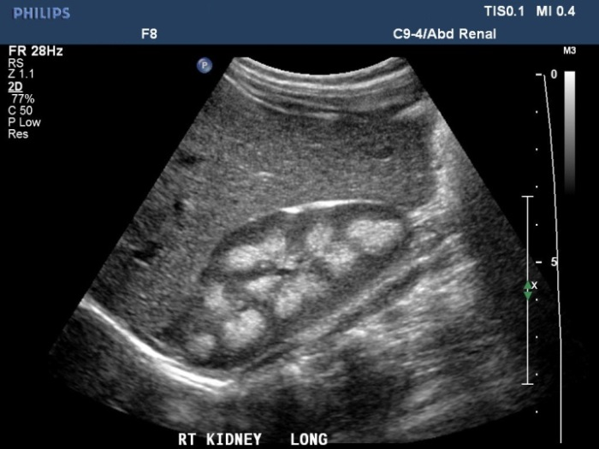
Symptoms of hypercalcemia
GI: nausea, vomiting, constipation, anorexia, abdominal pain, pancreatitis
Neurologic: pseudo-tumor cerebri, depression, confusion, fatigue, coma, hypotonia
Cardiovascular: hypertension, bradycardia, cardiac arrest, vascular calcification (chronic)
Renal: polyuria, dehydration, nephrocalcinosis
Kidney stones
Symptoms related to the severity of hypercalcemia
often asymptomatic if total Ca < 3 mmol/l

Slide 22
Physiopathological mechanisms leading to (sustained) hypercalcemia
Initiation of hypercalcemia
Maintenance of hypercalcemia

Slide 23

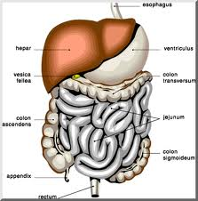

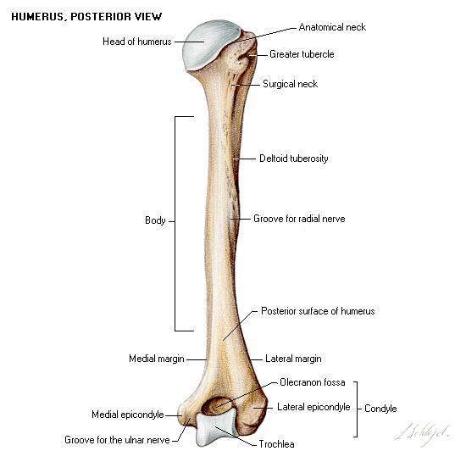
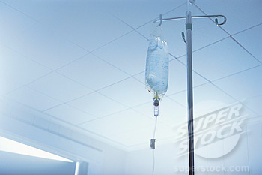
1. Initiation of hypercalcemia
Digestive
Calcium intoxication
Vitamin D intoxication
Granulomatous liver
disease
Bone metastasis
Bone disease
Bone
Overdose of calcium
Overdose of vitamin D
Iatrogenic
Williams syndrome
CYP24A1 mutations
Genetic

Slide 24



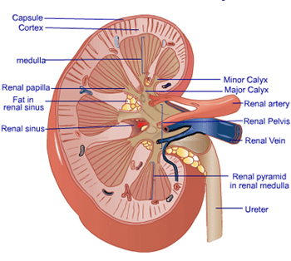

2. Maintenance of hypercalcemia
Slow release of vitamin
D from fat tissue
(days to weeks)
Continuous vitamin D
exposure
(variable)
Renal failure ±
chronic acidosis
(variable)

Slide 25
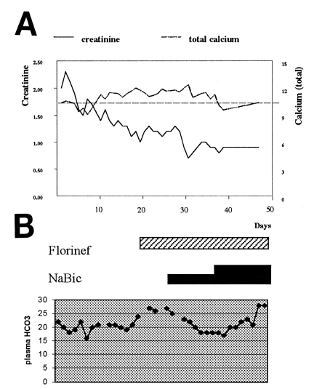

Slide 26
The question (you should ask yourself)
Does my patient take vitamin D?
    Vitamin D intoxication
Does my patient produce vitamin D?
    Granulomatous diseases
Does my patient take calcium?
    Calcium intoxication
Does my patient release calcium?
    Bone diseases

Slide 27
Differential diagnosis of hypercalcemia of infancy

Slide 28
The question (you should ask yourself)
What is the PTH level?
What is the 25(OH)Vitamin D level?

Slide 29
Hypercalcemia
PTH
Increased
Decreased
Loss of function CaSR mutation
Severe neonatal hyperPTH
↑ 25(OH)D
N/↓ 1,25(OH)D
N 25(OH)D
N/↑ 1,25(OH)D
↑ 1,25(OH)D
↓ 25(OH)D
PTHrP
Malignancy
Vitamin A intox.
Sarcoidosis
Granulomatosis
Fat necrosis
Vitamin D
intoxication
Williams syndrome
CYP24A1 mutation

Slide 30
Differential diagnosis hypercalcemia
From Lietman S et al. Curr Opin Pediatr 2010;22:508-15
Legends: NSHPT: neonatal severe hyperPTH; PTH: parathyroid hormone; PTHrP: parathyroid related protein

Slide 31
Vitamin D intoxication:
How does that happen?
How can we prevent it?
31

Slide 32
Vitamin D intoxication
32
Acute intoxication:
    Relatively well described
    From 40’000 IU per day for 3 to 4 months (= 3.6 millions to 4.8 millions)
    Most of the time > 1-2 million IU cummulative dose (see French experience)
Chronic intoxication:
    Relatively unclear
    From 2’000 to 4’000 IU per day for years

Slide 33
Vitamin D intoxication
Age cummulative dose duration of intoxication calcium level (mmol/l)
IU
7 w 6 millions 200’000 IU/d x 30 d 4.05
3 m 1.2 millions 3000’000 IU/d x 4 d 4.6
3 m 2.56 millions 302’000 IU/d x 8 days 4.5
6 m 3 millions 300’000 IU/d x 10 d 4.2
2 y 2.4 millions 600’000 IU/d x 4 d 3.6
11 m 1.34 millions 300’000 IU/m x 3 m 4.5
400 IU/d x 11 m
4 m 600’000 600’000 IU in 3 w 3.7
7 y 4.5 millions 300’000 IU x 15 d
7 m 1.8 millions 600’000 IU x 3 8.8
4 m 333’240 unclear 4.28
From: Chambellan-Tison C. Hypercalcemie majeure secondaire à une intoxication par la vitamine D. Arch Péd 2007;14:1328-1332

Slide 34
How common is it?
Number of cases reported to the ToxZentrum Zurich
With acute or chronic vitamin D3 intoxication
Sharp increase of
both acute and
chronic VitD3
intoxication over
the last decade

Slide 35

Why does that happen?
Multitude of vitamin D
available with different
dispensers and concentration

Slide 36
Case presentation: answers

Slide 37
Case presentation: answers
Case 1:
  Vitamin D hypersensitivity
  Mutation for CYP24A1 present
  Stop vitamin D
  Normal diet, normal milk
  Normalization of calcium level within 2 months

Slide 38
Case presentation: answers
Case 2:
  Metastatic poorly differentiated sarcoma with bone lesions and secondary hypercalcemia
  Treatment
    Hyperhydration
    Short-term treatment: calcitonin
    Long-term treatment: biphosphonate

Slide 39
Treatment of hypercalcemia

Slide 40
Treatment of hypercalcemia
Hyperhydration (hypercalcemia induces a state of diabetes insipidus with subsequent dehydration and low GFR)
Calcitonin
biphosphonates

Slide 41
Conclusions
Vitamin D and PTH play a major role in calcium control
Hypercalcemia is rare in paediatric, but can be life-threatening
Hypercalcemia usually does not last, unless there is a lasting aggression such as:
  Renal failure
  Continuous exposure to too much endogenous/exogenous vit D / calcium

Slide 42
Conclusions
Measuring calcium, phosphate, 25(OH)vit D and PTH level is often enough
Life threatening hypercalcemia is best treated with
  Hyperhydration
  Calcitonin
  biphosphonates

