Slide 1
Thé de fenouil et coliques

Slide 2
Fennel (Foeniculum vulgare). Fennel tea is a traditional remedy for colic, and some research suggests that fennel tea may help reduce colic symptoms. A breastfeeding mother can drink it. Fennel helps relax the gastrointestinal tract and get rid of gas. There is a report, however, that two infants suffered neurological damage when their mothers used an herbal product that contained fennel, among other ingredients.
http://umm.edu/health/medical/altmed/condition/infantile-colic
Herbal remedies — We do not suggest herbal remedies (eg, herbal teas, fennel seed, Gripe water [a mixture of herbs and water]) for the treatment of infantile colic. Although a few randomized trials suggest that specific herbal remedies may be beneficial in reducing crying compared with placebo [78-80], the benefits are largely unproven [71]. Given the lack of standardization and regulation of herbal products, the benefits do not outweigh the potential risks (eg, contamination with bacteria, toxins, or particulate matter; unlabeled ingredients, such as alcohol) [81-83]. Prolonged ingestion of herbal teas may lead to decreased milk intake [80].
2017

Slide 3
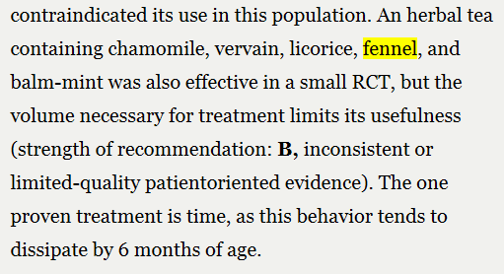
J Fam Pract. 2006 July;55(7):634-635

Slide 4
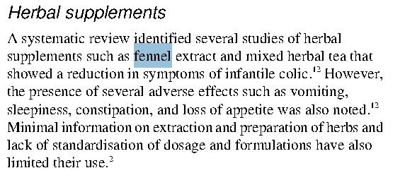

Slide 5
Ital J Pediatr. 2012; 38: 34.

