Slide 1
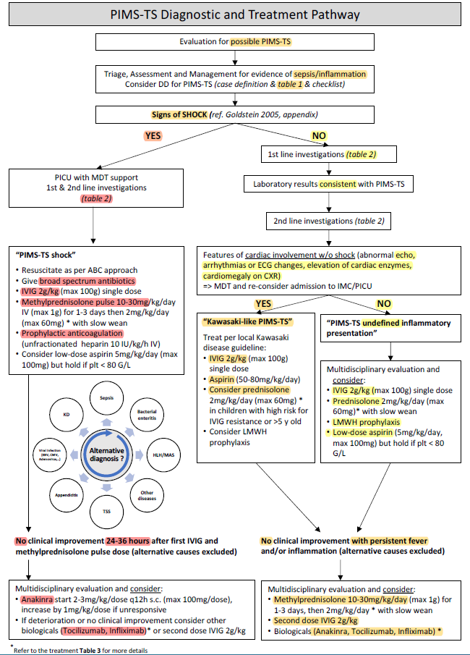
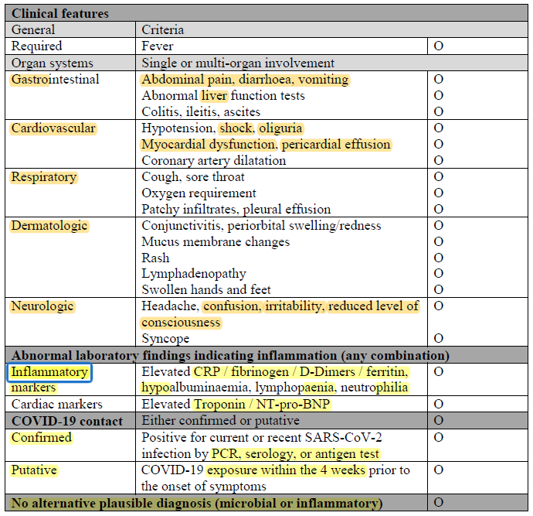
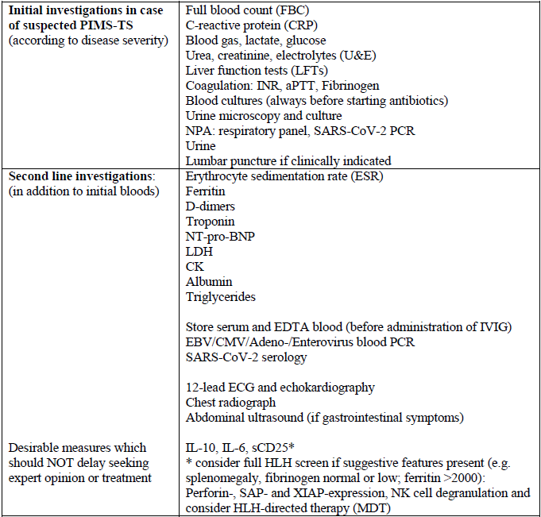
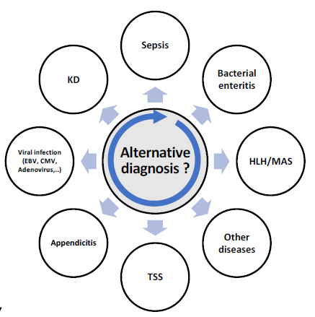
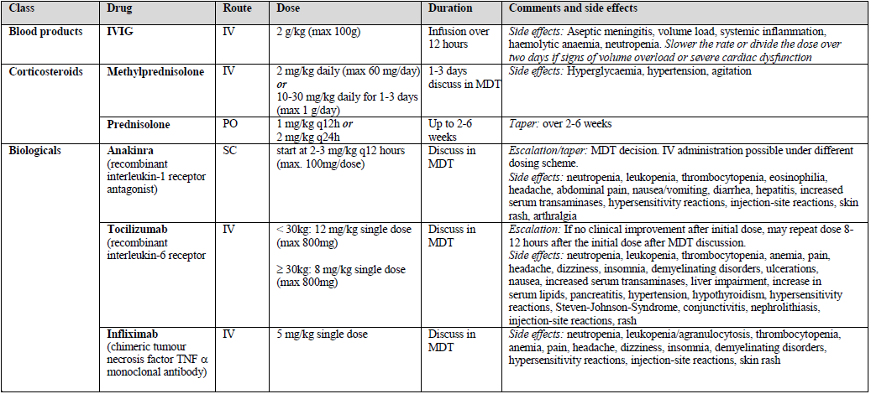
Table 1. List of diagnostic criteria for PIMS-TS. Patients must be below 18 years and meet at least one criterion for each group, including i) presence of fever, ii) organ involvement, iii) laboratory evidence of inflammation, iv) microbiologically proven or putative COVID-19 contact, and v) exclusion of other causes.
Table 2. Recommendations for diagnostic work-up in children evaluated for PIMS-TS. Note: where possible, PIMS-TS patients should be enrolled in observational or interventional studies, which may include additional diagnostics.
Table 3. Anti-inflammatory therapies in patients with PIMS-TS. DISCLAIMER: Medication dosing and administration should be checked with the local hospital pharmacists and considering recent evidence updates. Where possible, PIMS-TS patients should be enrolled in interventional studies

