Slide 1
DIAGNOSTIC DIFFERENTIEL ?

Slide 4
QoL: Quality of Life

Slide 6
PHACE: Posterior fossa brain malformations, Hemangioma, Arterial lesions, Cardiac abnormalities, and Eye abnormalities

Slide 10
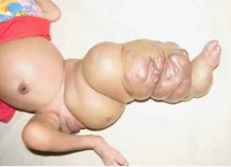
KLIPPEL TRENAUNAY

